Slide 1
MATLAB and Keysight Scopes
Diego Sena
Summer 2023

Slide 2
Goals and Objectives
Control the KEYSIGHT Scope with MATLAB
Analyze the bandwidth of the scope and scope cables

Slide 3
So What? Why is this important
To characterize the maximum frequency sampleable by the scope and scope cables
To confirm the manufactures specifications
Tells engineers what signals they can and can’t measure with each piece of equipment

Slide 4
Plan of Record
Part 1 -> Develop MATLAB script to control scope and analyze data
Part 2 -> Test script against known waveforms
Part 3 -> Find Nyquist and bandwidths of scopes and probes with MATLAB script

Slide 5
Test Plan
What are the specifications you will test to: what does it mean to “work?”
Can accurately collect and process data and produce an FFT
What will you measure?
1Vpp 30 MHz Sin Wave
What are the tests you will do?
What is a measure of success?

Slide 6
Literature Search, Background
Understand DFT and FFTs
IVI library
MATLAB

Slide 7
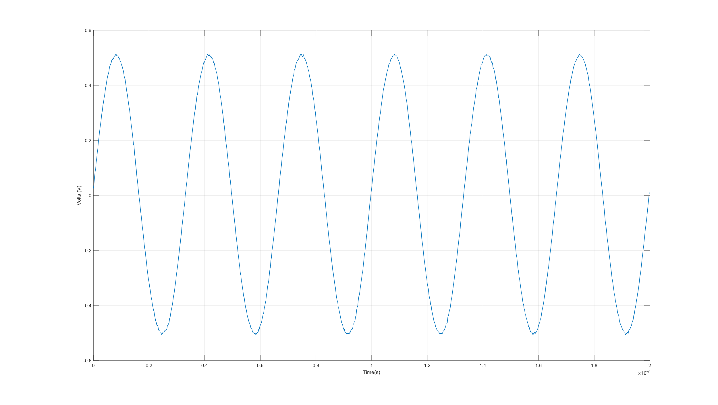
30 MHz Sin Wave

Slide 8
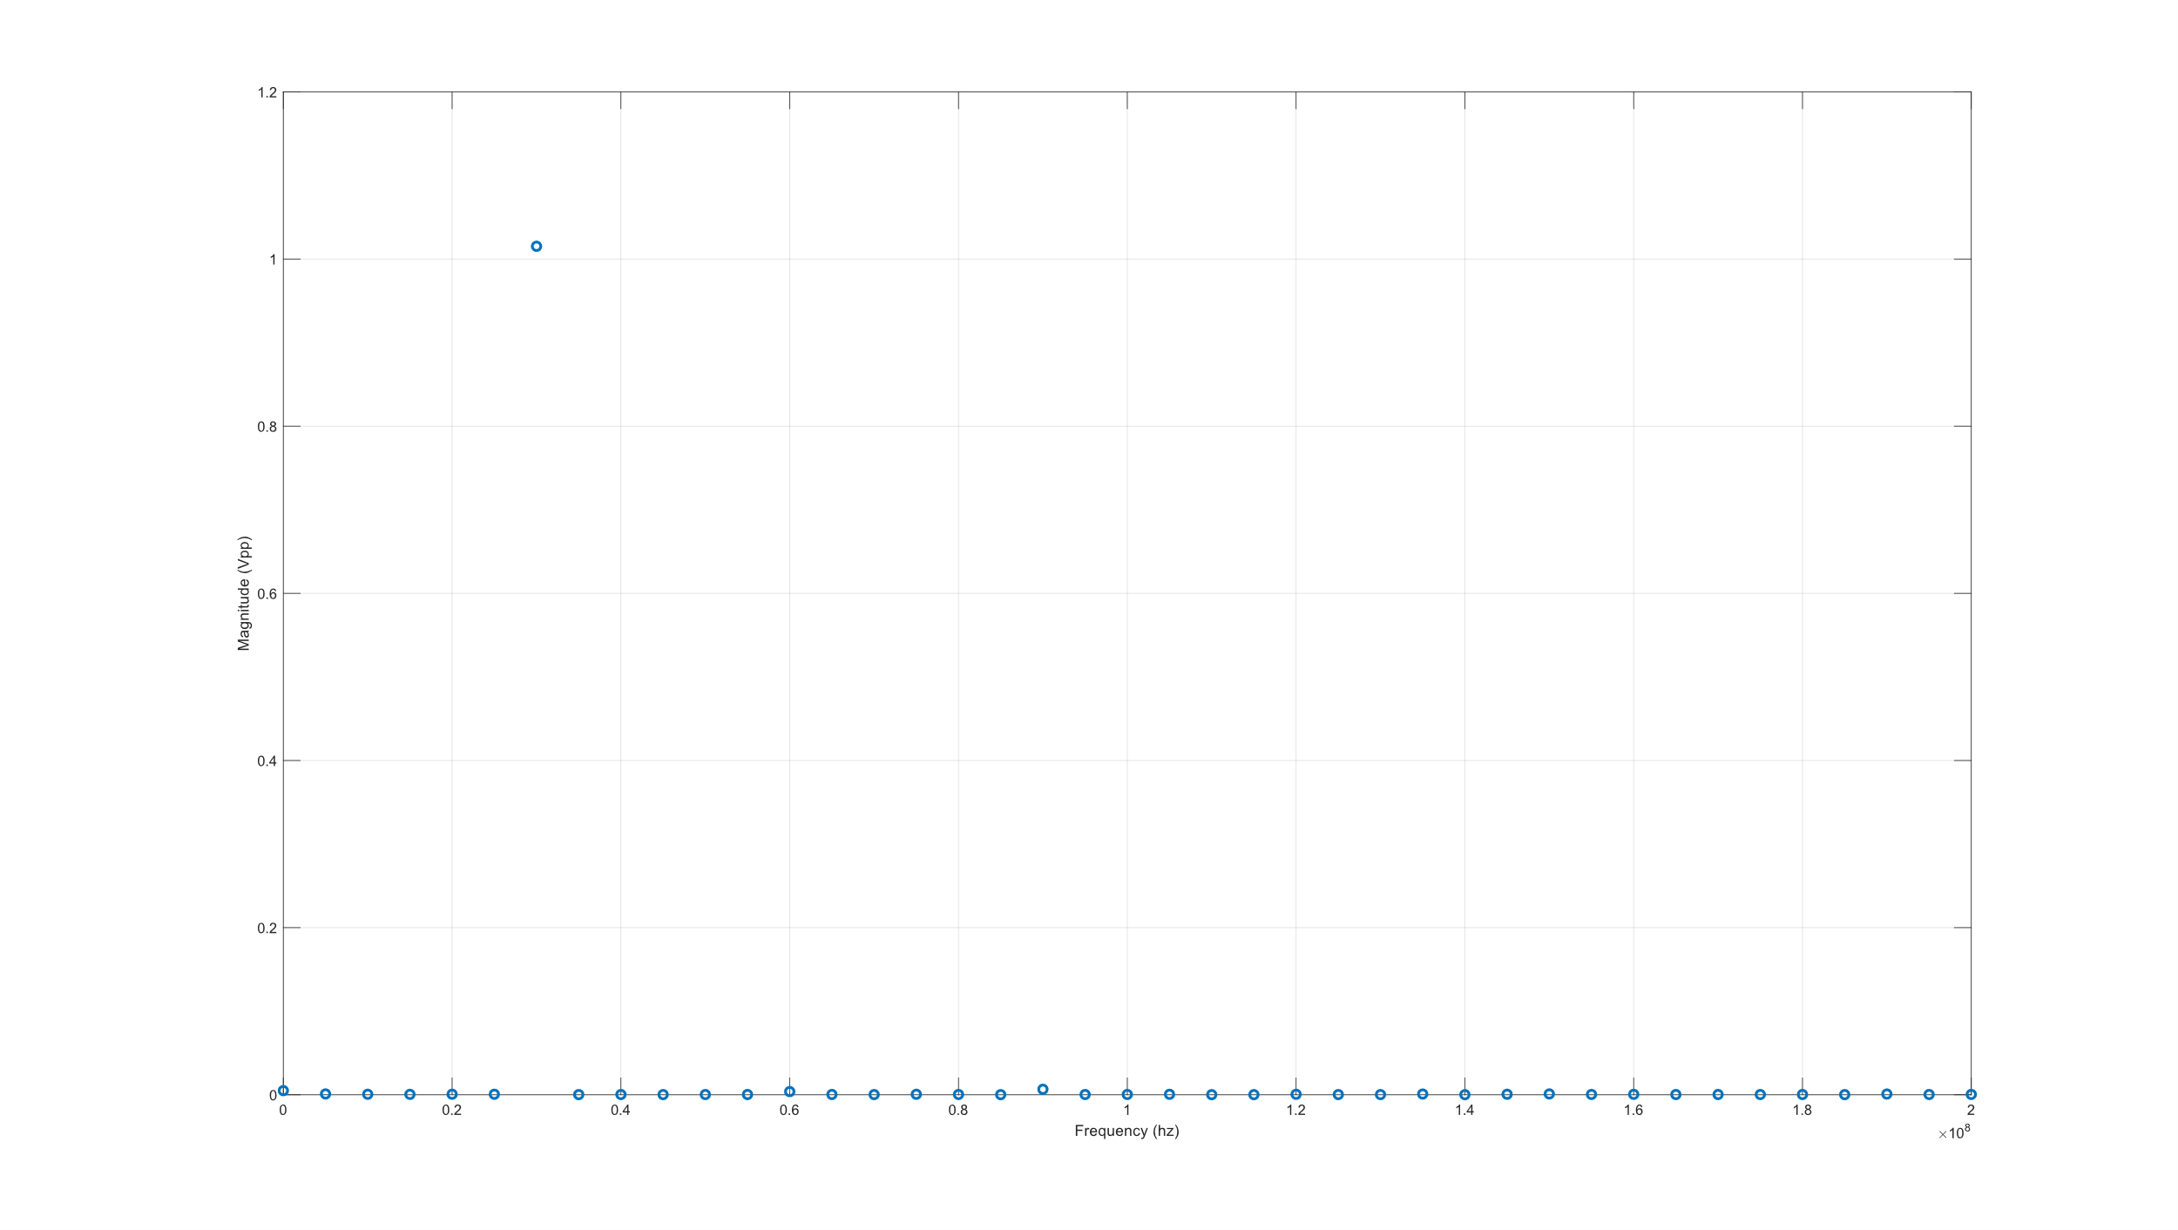
30 MHz Sin Wave FFT

Slide 9
What was accomplished last week
Connected the computer and scope
Pull data from the scope
Plot data from the scope
Analyze data from the scope

Slide 10
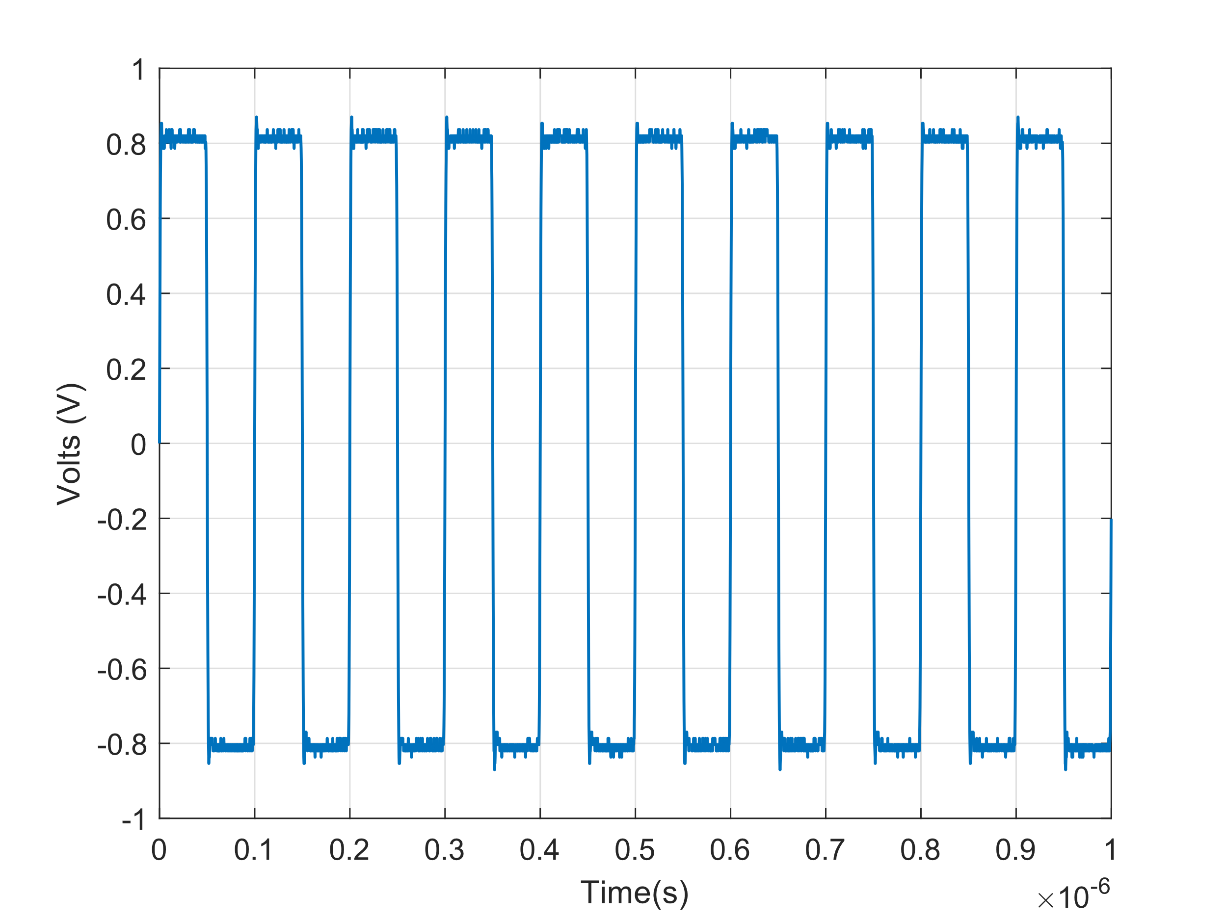
Square Wave From Scope

Slide 11
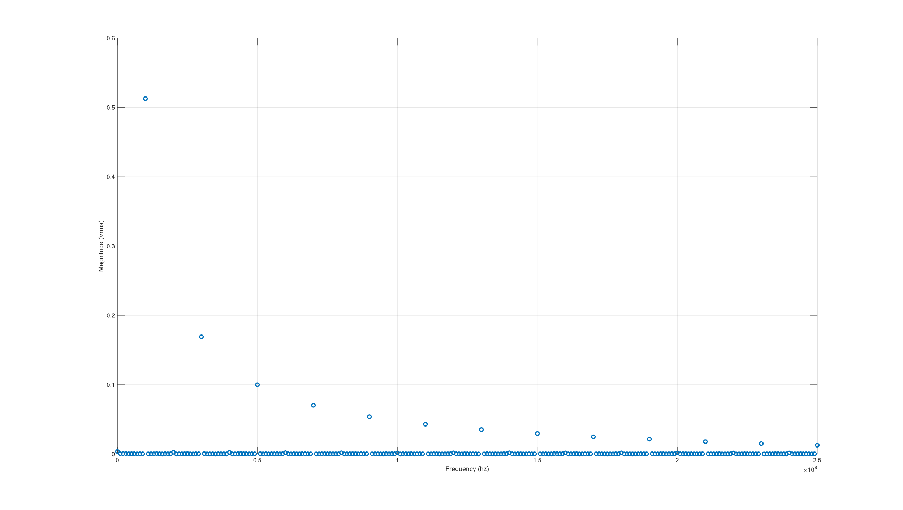
FFT of Square Wave

Slide 12
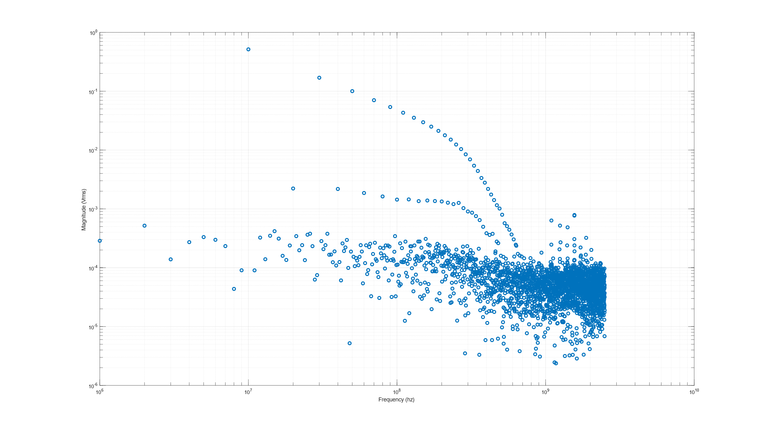
LogLog FFT of Square Wave

Slide 13
Progress to the Goal

